Slide 1
V-Lab Step-by-Step Guide
Le Xu
2011-08-29

Slide 2
What is V-Lab?
V-Lab is a Cloud-based Virtual Resource and Service Sharing Platform for Computer and Network Security Education.
Compose, configure, perform and manage a virtual computer networking system for students to simulate real-life situation.
V-Lab Cloud
Students perform labs locally
in physical network environment
Students perform labs remotely in virtual network environment

Slide 3
CSE468/598 Network Security Lab
3 Virtual Machines: Gateway, Server and Client
Gateway: a router for IP forwarding, firewall rules, etc.
Server: provides services: Http, Ftp, etc.
Client: accesses services via Gateway.
2 Virtual Networks
Network1: server – gateway
Network2: client - gateway

Slide 4
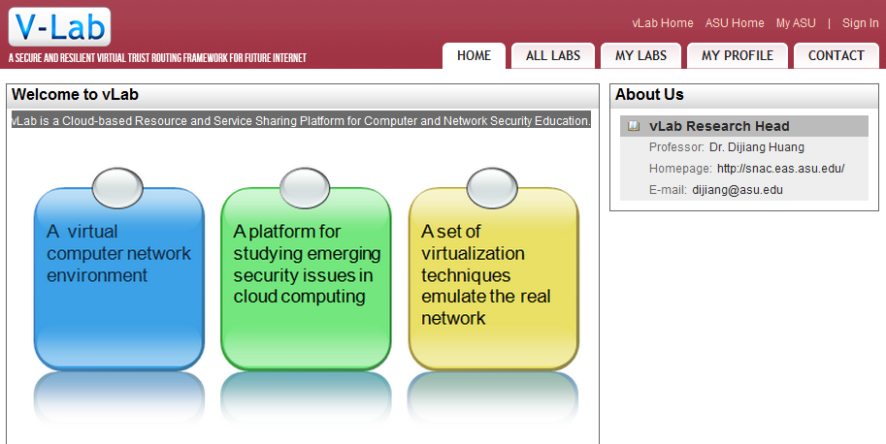
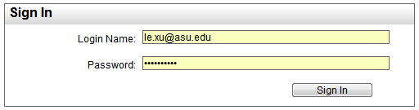
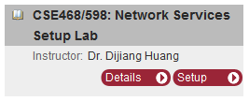
V-Lab Website
Go to http://vlab.asu.edu
Click ‘Sign in’ on top right corner.
Use the account info in the email to sign in
Click ‘Setup’ on the right column
Start using virtual resources
Next page…

Slide 5
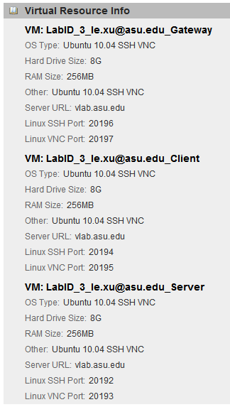
V-Lab Virtual Resources Remote Access
VM: Gateway
SSH Port:
VNC Port:
VM: Client
SSH Port:
VNC Port:
VM: Server
SSH Port:
VNC Port:
SSH
Secure Shell
Local Port: 22
VNC
Virtual Network Computing
Local Port: 5900, 5901, …
In V-Lab, we use port mapping to open remote access to students.

Slide 6
V-Lab Virtual Resources Remote Access
A: SSH Client sends request to vlab.asu.edu:20196
B: DNS resolves vlab.asu.edu to 129.219.17.123
C: V-Lab Gateway maps port 20196 to 192.168.0.1:22
D: SSH request sent to your own VM.
Your VM
other VM

Slide 7
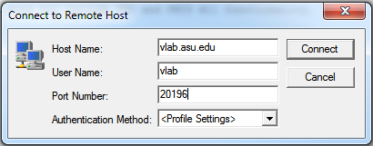
Task1: SSH connection to your VM
Download and install SSH Client software.
Go to http://vlab.asu.edu, click on ‘Support’, download the SSH Client software from left column.
Follow the steps to install SSH Client.
Find out your VM’s SSH port number.
Make a connection to your VM via SSH.
Open ‘Secure Shell Client’.
Click on ‘Quick Connect’.
Input destination address and port. User ‘vlab’ as user name.
Use your VM’s SSH port here!

Slide 8
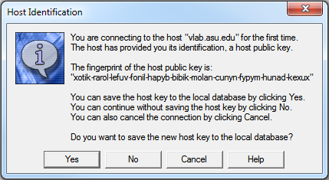
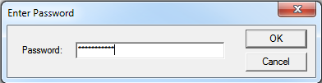
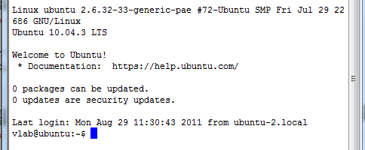
Task1: SSH connection to your VM (cont.)
Click Connect
Input default password: ‘pa$$word123’
You should see your VM’s shell:
Repeat the steps to connect to all 3 VMs. Remember the server, client and gateway SSH window locations.

Slide 9
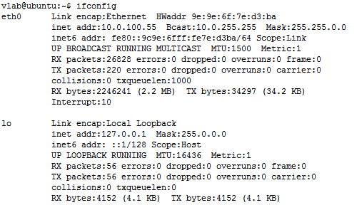
Task2: Configure Networks
In VM shell, type: ifconfig, enter.
You can see 2 interfaces:
eth0: 10.0.100.x, 10.0.255.255, 255.255.0.0
lo: 127.0.0.1, 255.0.0.0, n/a
Note: eth0 is for remote access only. Do NOT touch eth0 on any VM. Or you may lose connection to your VM.

Slide 10
Task2: Configure Networks
Goal: Configure Server and Gateway, so they can ping each other on network1.
In Server VM, type ifconfig. You can’t see eth1 which is hidden at the moment.
Get super user privilege: sudo –i, then type your password: pa$$word123, enter.
Type: ifconfig eth1 up
Type: ifconfig again and you should see eth1 is up. However, eth1 is not configured at the moment.

Slide 11
Task2: Configure Networks
Change Linux network interface configuration file to set Server eth1 IP address.
Type: cd /etc/network
Type: vim interfaces
Type: i, to enable editing mode.
Insert text at the end of the file: auto eth1 iface eth1 inet static address 192.168.0.2 netmask 255.255.255.0 gateway 192.168.0.1
Save file by typing: ESC, :wq, enter
Restart network: /etc/init.d/networking restart
Type: ifconfig again and verify IP of eth1.

Slide 12
Task2: Configure Networks
Go to Gateway VM, use ifconfig eth1 up to turn on eth1.
Repeat previous steps to configure eth1 of Gateway: auto eth1 iface eth1 inet static address 192.168.0.1 netmask 255.255.255.0 gateway 192.168.0.1
Restart Gateway network and verify IP address.
Go to server, type: ping 192.168.0.1
Go to gateway, type: ping 192.168.0.2
Try ping 192.168.0.3 on server. What will happen?

Slide 13
Task3: Configure Networks
Goal: Configure Client and Gateway, so they can ping each other on network2.
Follow the previous steps to show eth1 on Client VM and eth2 on Gateway VM.
Configure Client VM eth1: auto eth1 iface eth1 inet static address 172.16.0.2 netmask 255.255.0.0 gateway 172.16.0.1
Restart network and verify IP address of eth1.

Slide 14
Task2: Configure Networks
Go to Gateway VM, insert text at the end of interfaces file: auto eth2 iface eth2 inet static address 172.16.0.1 netmask 255.255.0.0 gateway 172.16.0.1
Restart network and verify IP of eth2.
Go to Client, type: ping 172.16.0.1
Go to Gateway, type: ping 172.16.0.2
What will happen if you ping 192.168.0.1 on Client VM? Why?

Slide 15
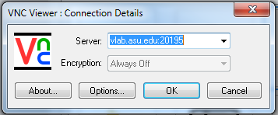
Task3: Install Web Server
Goal: Install a web server on Server VM using apt-get.
Go to Server VM, type: apt-get update, Wait for it to finish.
Type: apt-get install apache2, type Y, enter. Wait for it to finish.
Download & start VNC Client software from V-Lab website.
Find out your Server VM’s VNC port number on V-Lab website.
Type: vlab.asu.edu:<your VNC port>, and click OK.
Use password: pa$$word123 to sign in.

Slide 16
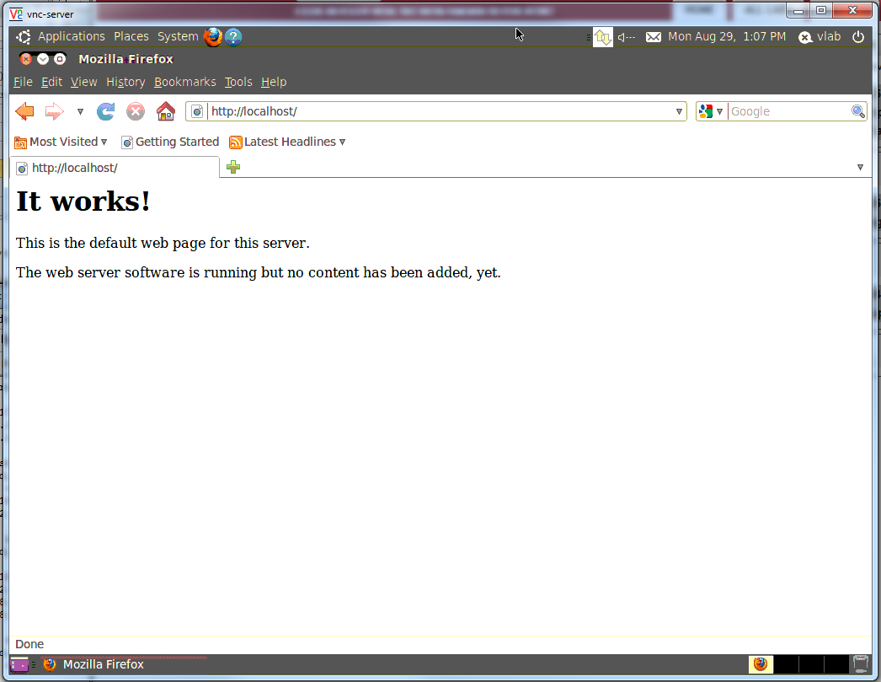
Task3: Install Web Server
Open Firefox on the top bar.
Type URL: localhost, enter
You can see the web server on server VM is working.

Slide 17
Task4: Access Web Server from Client
Goal: access web server hosted on Server VM from Client VM through Gateway.
Open VNC client, find out Client VM’s VNC port and establish a VNC connection to Client VM.
Open Firefox on Client VM, type URL: 192.168.0.2
Question: What will happen?
Go to Gateway SSH shell, type: vim /etc/sysctl.conf
Find the line: #net.ipv4.ip_forward=1
Type: i to enable editing, uncomment the line by removing the #. Save file by ESC, :wq, enter
Type: sysctl -p /etc/sysctl.conf to apply changes.
Go to Client VM’s VNC window, try reload URL: 192.168.0.2, you should see ‘It works!’. Your gateway is forwarding your request from network2 to network1.

Slide 18
Thank you!
Questions?

